Slide 1
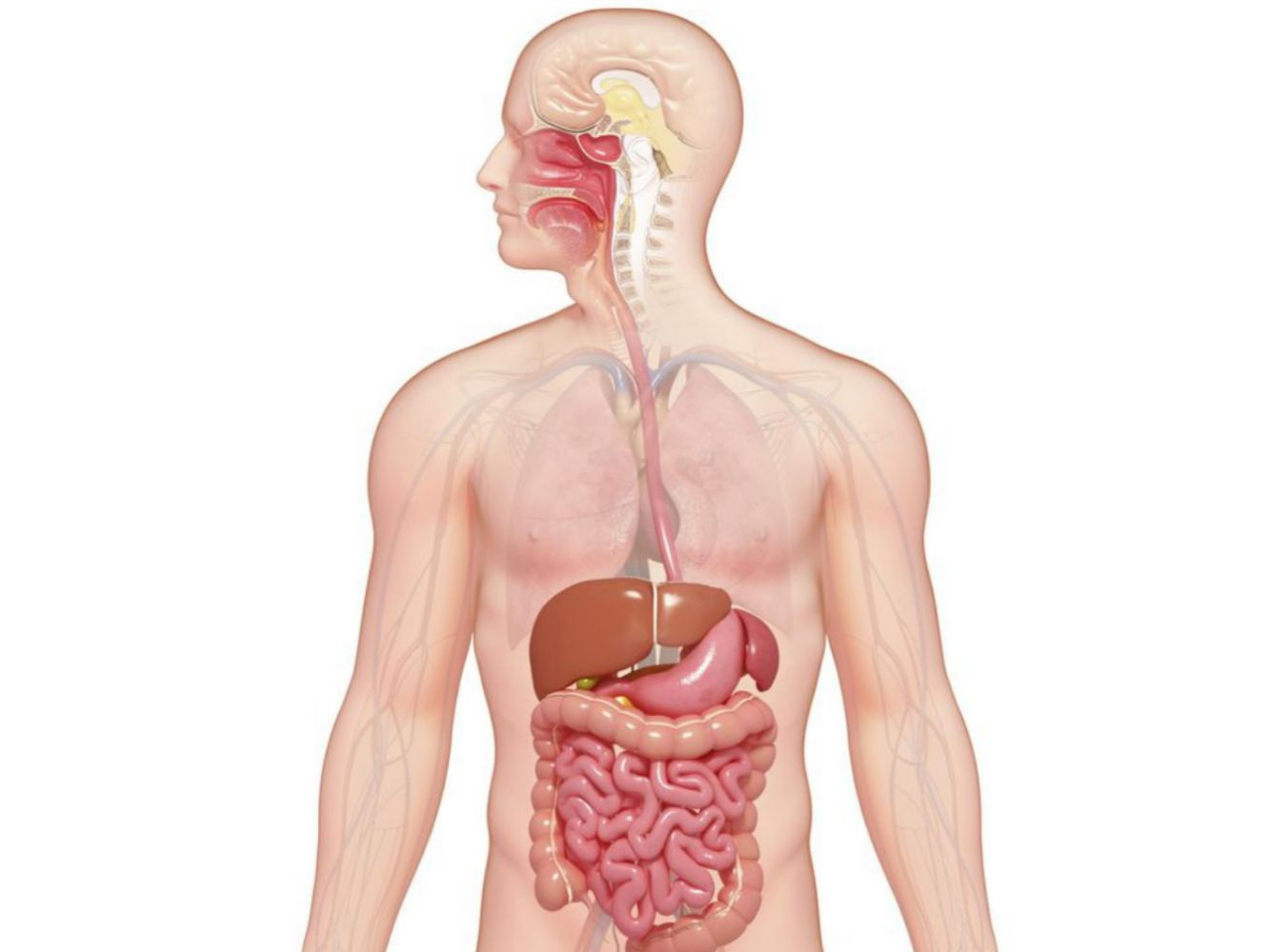
DIGESTIVE SYSTEM
We will identify the parts of the digestive system and their functions
Notes:
Insert cover image and use transparency settings to fade image.

Slide 2
Do not delete this slide.
This slide is designed so that you can copy the prompt box you need and insert it into your slides.
This slide is hidden and will not be included when presenting your lesson.
TRACK WITH ME
VOCABULARY
1 -
HINT
Students, remember….
CHECK FOR UNDERSTANDING
READ WITH ME
TEACHER CUE
MAKE THE CONNECTION
Students, you already know….
EXTENSION
GESTURE WITH ME

Slide 3
1. Name the parts of the respiratory system:
M
P
L
T
B
B
A

Slide 4
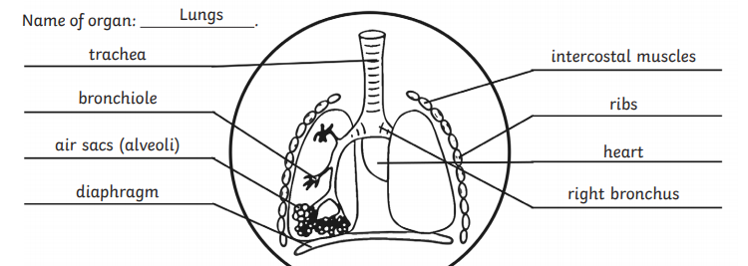
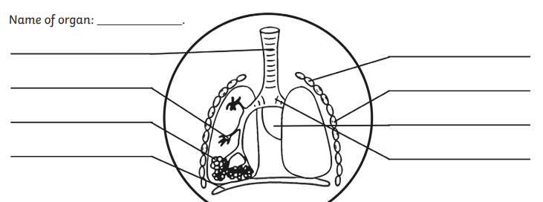
Label the parts of the respiratory system:

Slide 5
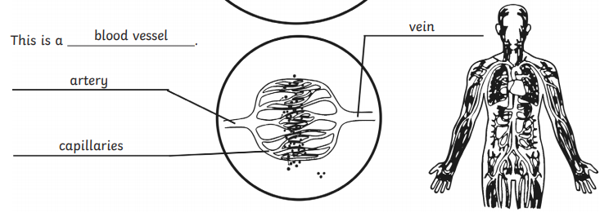
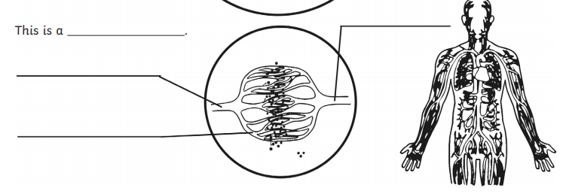
Fill in the parts:

Slide 6
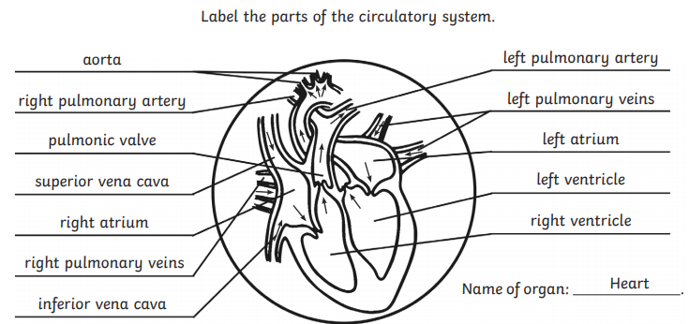
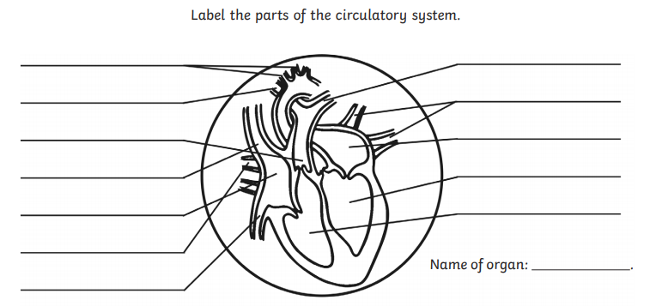

Slide 7
Repeat the opposite word/phrase.
INDEPENDENT VARIABLE
VARIABLE THAT IS CHANGED ON PURPOSE

Slide 8
Repeat the opposite word/phrase.
DEPENDENT VARIABLE
VARIABLE THAT IS MEASURED AND CHANGES

Slide 9
We will describe the functions of the digestive system
TRACK WITH ME
READ WITH ME
We will define the digestive system
We will define the parts of the system
We will identify the functions of the system
We will link the digestive system to the circulatory and respiratory system
DECLARE THE OBJECTIVE
Read the learning objective to your partner.
Notes:
Learning Objectives contain concepts (nouns, big ideas), skills (verbs, measurable behaviours) and sometimes context (restricting or targeting conditions).
●Example: Students will be able to describe the concept of density and apply it to floating and sinking.
●
Success criteria are specific measurable outcomes that if met mean that the student has met the learning objective.
Examples:
•Students will be able to compare densities of substances using mass and volume.
•Students will be able to identify whether a solid or liquid will float or sink in a liquid based on their densities.

Slide 10
We will describe the functions of the digestive system
Write your own definition of digestion
Why do you think digestion is important?
Draw a flow chart of digestion.
MAKE THE CONNECTION
Students, you already know what substance breaks down food in your body

Slide 11
Digestion
The process of breaking down food.

Slide 12
Nutrient
A substance that provides nourishment essential for the maintenance of life and growth.
Examples: carbohydrates, lipids, proteins, amino acids, vitamins, minerals.

Slide 13
Repeat the opposite word/phrase.
MECHANICAL
PHYSICAL

Slide 14
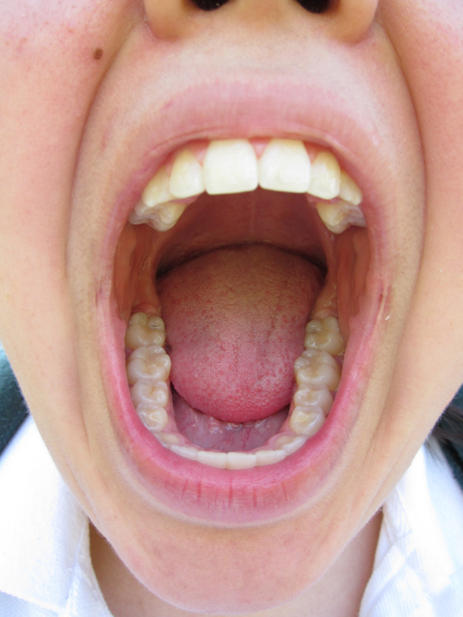
We will describe the functions of the digestive system
What characteristic of living things involves digestion?
Nutrients
HINT
All living things have characteristics of MRS GREN

Slide 15
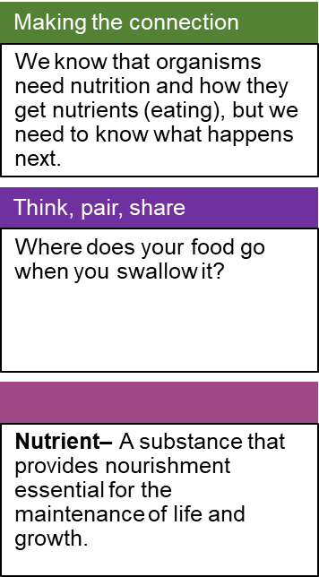
We will describe the functions of the digestive system
Heterotrophs (consumers) get their nutrition and energy by consuming other organisms.

Slide 16
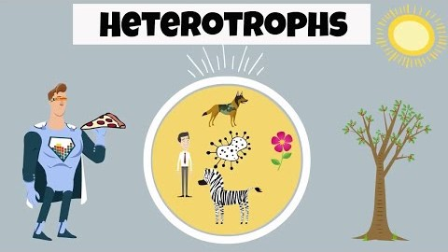
We will describe the functions of the digestive system
Make a list of organisms that the heterotrophs in this video consume.

Slide 17
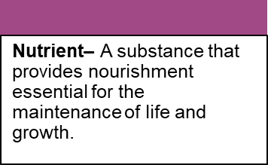
Digestive System
The system that is responsible for extracting nutrients from the food that an organism eats.
Please add this to your concertina sheet

Slide 18
We will describe the functions of the digestive system
There are two types of digestion:
Draw a picture in your table for both
Mechanical Digestion: | Chemical Digestion:
Food is physically broken into smaller parts by the act of chewing and churning. | Food is chemically broken down by the action of chemical agents.

Slide 19
We will describe the functions
Draw and label the parts of the digestive system (leave lots of space)
5 minutes
End

Slide 20
We will describe the functions
Mouth: when you chew the digestive process begins
Salivary glands: make saliva, a digestive juice, which moistens food so it moves more easily into your stomach.
Saliva also has an enzyme that begins to break down starches in your food.
Label you diagram with this information
Notes:
ONLY ANNOTATE BLACK IF LOWER ABILITY

Slide 21
We will describe the functions
Oesophagus: After you swallow, peristalsis pushes the food down your Oesophagus into your stomach.
Stomach: Glands in your stomach lining make stomach acid and enzymes that break down food.
Muscles of your stomach mix the food with these digestive juices.
Label you diagram with this information

Slide 22
We will describe the functions
Pancreas: Your pancreas makes a digestive juice that has enzymes that break down carbohydrates, fats, and proteins.
The pancreas delivers the digestive juice to the small intestine through small tubes called ducts.
Liver: Your liver makes a digestive juice called bile that helps digest fats and some vitamins.
Bile ducts carry bile from your liver to your gallbladder for storage, or to the small intestine for use.
Label you diagram with this information

Slide 23
We will describe the functions of the digestive system
TRACK WITH ME
READ WITH ME
We will define the digestive system
We will define the parts of the system
We will identify the functions of the system
We will link the digestive system to the circulatory and respiratory system
DECLARE THE OBJECTIVE
Read the learning objective to your partner.
Notes:
Learning Objectives contain concepts (nouns, big ideas), skills (verbs, measurable behaviours) and sometimes context (restricting or targeting conditions).
●Example: Students will be able to describe the concept of density and apply it to floating and sinking.
●
Success criteria are specific measurable outcomes that if met mean that the student has met the learning objective.
Examples:
•Students will be able to compare densities of substances using mass and volume.
•Students will be able to identify whether a solid or liquid will float or sink in a liquid based on their densities.

Slide 24
1.What are the two types of digestion and where do they occur?
2. Label the parts of the respiratory system:

Slide 25
We will describe the functions of the digestive system
TRACK WITH ME
READ WITH ME
We will define the digestive system
We will define the parts of the system
We will identify the functions of the system
We will link the digestive system to the circulatory and respiratory system
DECLARE THE OBJECTIVE
Read the learning objective to your partner.
Notes:
Learning Objectives contain concepts (nouns, big ideas), skills (verbs, measurable behaviours) and sometimes context (restricting or targeting conditions).
●Example: Students will be able to describe the concept of density and apply it to floating and sinking.
●
Success criteria are specific measurable outcomes that if met mean that the student has met the learning objective.
Examples:
•Students will be able to compare densities of substances using mass and volume.
•Students will be able to identify whether a solid or liquid will float or sink in a liquid based on their densities.

Slide 26
Digestion
The process of breaking down food.

Slide 27
Nutrient
A substance that provides nourishment essential for the maintenance of life and growth.
Examples: carbohydrates, lipids, proteins, amino acids, vitamins, minerals.

Slide 28
We will describe the functions of the digestive system
Mechanical digestion takes place in:
The mouth.
stomach.
small intestine.
two of the above

Slide 29
We will describe the functions of the digestive system
Which organ produces digestive enzymes that help to digest carbohydrates, fats and proteins?
Pancreas
Liver
Gall bladder
Salivary glands

Slide 30
We will describe the functions
Find your diagram from yesterday:
End
1
2
3
4
5
6
7
8
9
10
11
12
13
14
15
16
17
18
19
20
21
22
23
24
25
26
27
28
29
30
31
32
33
34
35
36
37
38
39
40
41
42
43
44
45
46
47
48
49
50
51
52
53
54
55
56
57
58
59
60

Slide 31
We will describe the functions
Gallbladder: Stores bile between meals.
When you eat, your gallbladder squeezes bile through the bile ducts into your small intestine
Small Intestine: Makes digestive juice, which mixes with bile and pancreatic juice to complete the breakdown of proteins, carbohydrates, and fats.
Bacteria in your small intestine make some of the enzymes you need to digest carbohydrates.
Your small intestine absorbs some water but mainly nutrients.
Label you diagram with this information

Slide 32
We will describe the functions
Large Intestine: more water is absorbed into your bloodstream.
Bacteria in your large intestine help break down remaining nutrients.
Waste products of digestion, including parts of food that are still too large, become stool.
Rectum: the final section of the large intestine, terminating at the…
Anus: The opening at the end of the digestive system through which solid waste matter leaves the body.

Slide 33
We will describe the functions of the digestive system
What is the function of the small intestine?
What is the function of the large intestine?
What is the function of the stomach?
What is the function of the mouth?
What is the function of the pancreas?
What is the function of the liver?
Twenty second review:
10 house points up for grabs!
End
1
2
3
4
5
6
7
8
9
10
11
12
13
14
15
16
17
18
19
20

Slide 34
We will describe the functions of the digestive system
We all have digestive systems.
Understanding how your digestive system works allows you to make decisions about your body and your health.

Slide 35
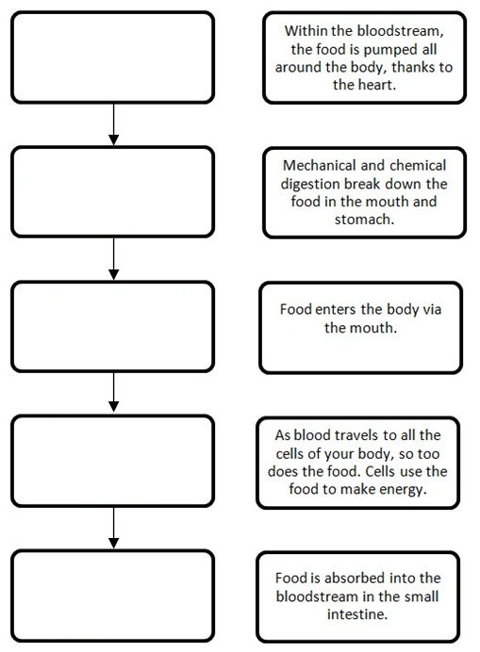
Write the descriptions of digestion into the correct order in a flow chart in your book

Slide 36
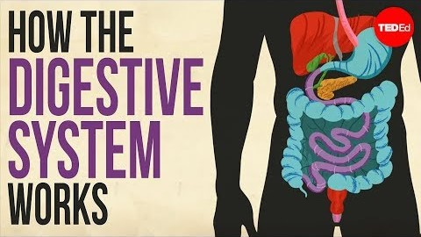
Label the parts of the respiratory system:

Slide 37
We will describe the functions of the digestive system
TRACK WITH ME
READ WITH ME
We will define the digestive system
We will define the parts of the system
We will identify the functions of the system
We will link the digestive system to the circulatory and respiratory system
DECLARE THE OBJECTIVE
Read the learning objective to your partner.
Notes:
Learning Objectives contain concepts (nouns, big ideas), skills (verbs, measurable behaviours) and sometimes context (restricting or targeting conditions).
●Example: Students will be able to describe the concept of density and apply it to floating and sinking.
●
Success criteria are specific measurable outcomes that if met mean that the student has met the learning objective.
Examples:
•Students will be able to compare densities of substances using mass and volume.
•Students will be able to identify whether a solid or liquid will float or sink in a liquid based on their densities.

